Slide 1

Predictive Modelling of University Dropouts
Team 2 – The Cabbages
Project 4 Data Visualisation Bootcamp
Yasar, Tooba, Musab, Ifa & Zeeshan

Slide 2


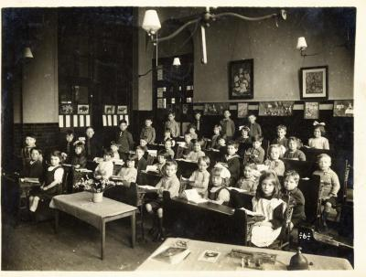
History of education
Our dataset focuses on higher education and the factors that influence student outcomes, specifically dropouts and completions.
Notes:
Universities have come a long way since their early days in the medieval period.
In our globalized world, we've observed that universities grapple with ensuring student retention and success. Factors such as socio-economic background, academic performance, and personal circumstances play a pivotal role – elements that we've aimed to analyze in our dataset.

Slide 3

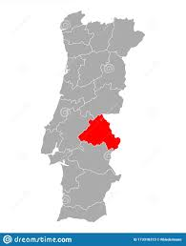
Dataset
Portuguese data from the Polytechnical Institute of Portalegre.
Data from 2008/9 - 2018/19 academic years
17 different undergraduate degrees
4424 records
35 attributes (columns)
Notes:
e.g agronomy, design, education, nursing, journalism, management, social service, and technologies
our dataset sources Kaggle and used csv file.
The data has been compiled from data held by the Portugese equivalent of UCAS:

Slide 4
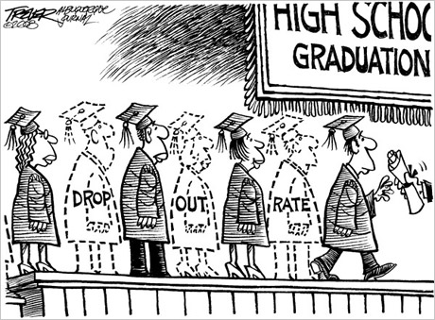
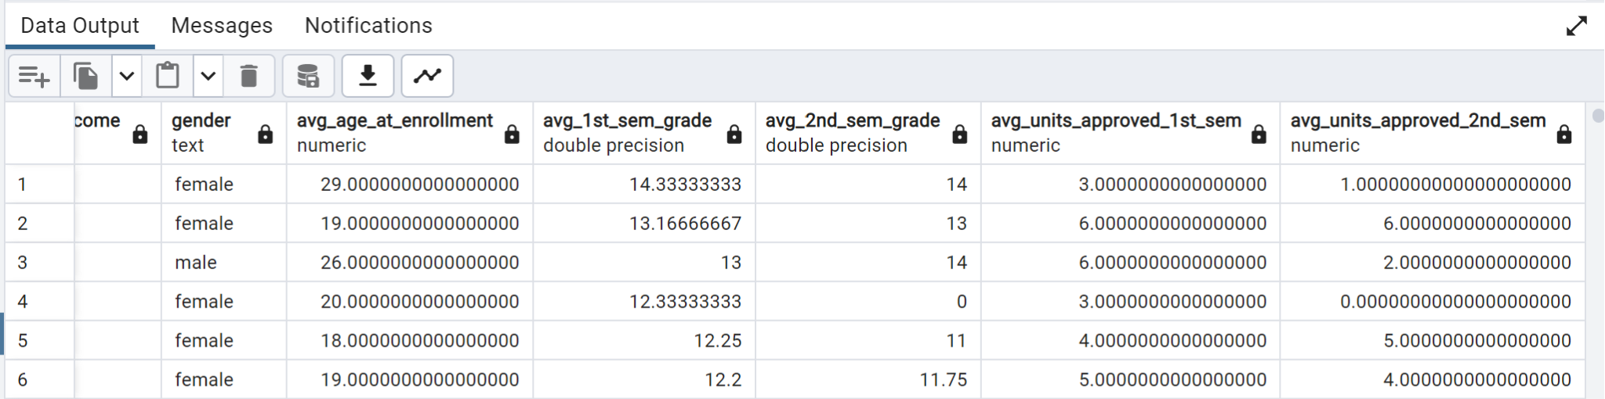
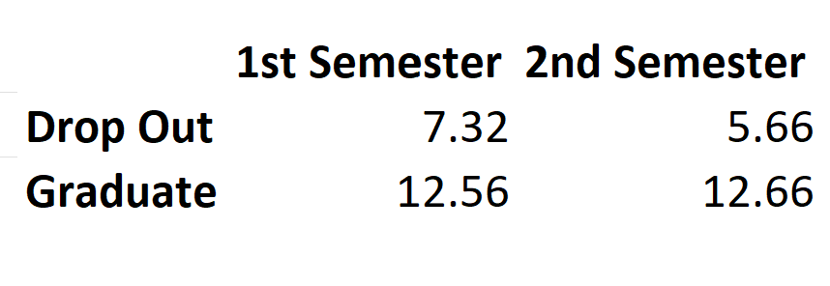
SQL Queries Overall Academic Performance by Outcome
Notes:
To comprehend our dataset and explore potential insights, we began by creating tables and importing our data into an SQL database. we then executed a query to calculate the average performance metrics based on outcomes and gender.
Notably, the DROPOUTS showed lower grades of 7.32 for 1st semester and 5.66 for 2nd semester, while "GRADUATES" excelled with 12.56 for 1st semester and 12.66 for 2nd semester
What's clear from these numbers is that academic performance, especially as indicated by the semester grades, is a strong predictor of student outcomes.
Those with lower grades are more likely to drop out compared to their counterparts.

Slide 5
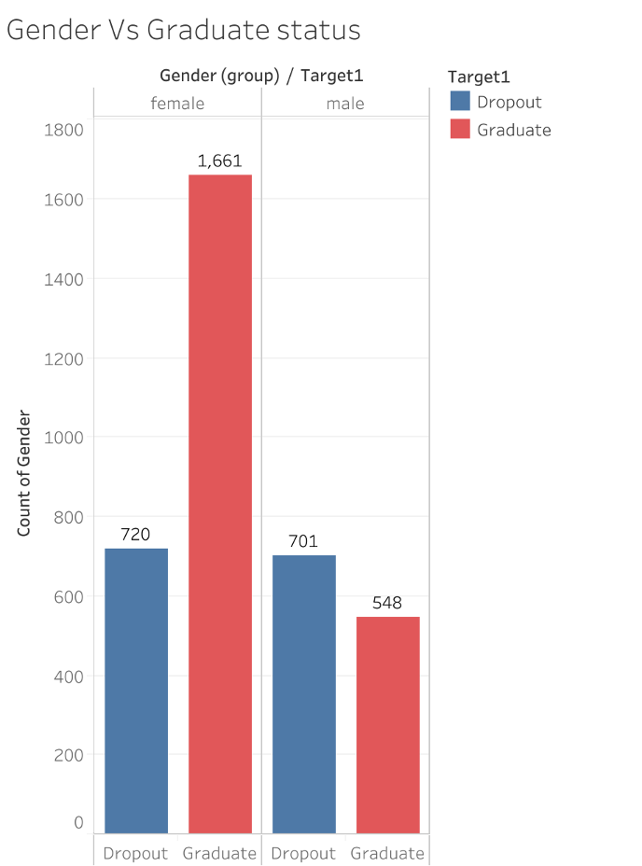
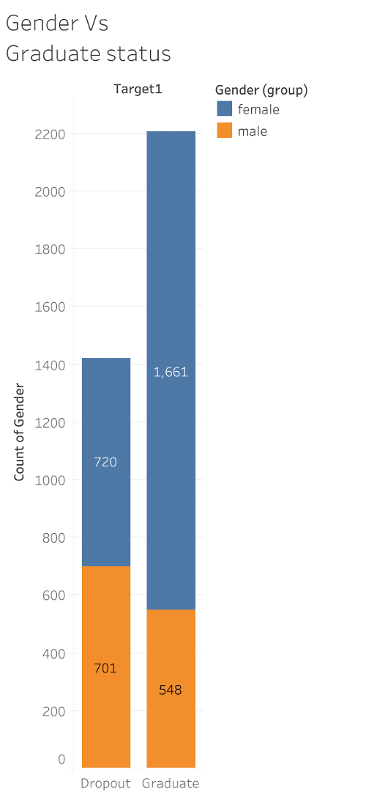
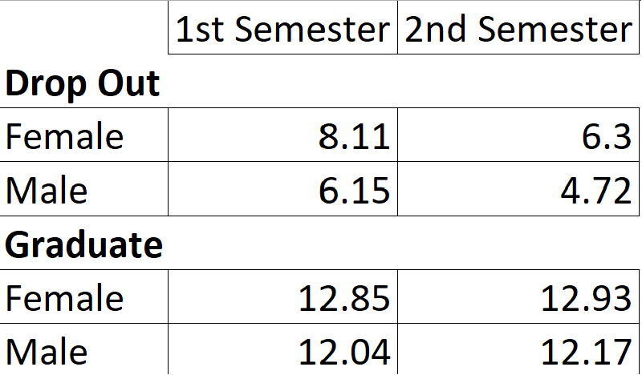

Analysis by Gender
Notes:
we then did a bit of analysis into the influence of gender on average academic performances:
For dropouts, females' grades decreased from 8 to 6 between the 1st and 2nd semesters, while males' grades dropped from 6.15 to 4.72. For graduates, females demonstrated a slight increase in grades, going from 12.85 to 12.93, while males' grades improved from 12.04 to 12.17 between the 1st and 2nd semesters.
The data indicates that, regardless of the outcome, females consistently achieve higher grades than males, suggesting that gender may play a substantial role in academic performance and results.
based on our initral findings, we propose implementing proactive measures for students whose grades fall below a specific threshold, providing them with additional academic support to enhance their educational outcomes.

Slide 6



Data Cleaning and Processing
REMOVED THE ENROLLED ROWS (APPROXIMATELY 700 ROWS)
REMOVED THE APPLICATION MODE AND ORDER. THIS INFORMATION WAS ADMINISTRATIVE AND COULD POTENTIALLY CONFUSE OUR MODELLING ANALYSIS.
IMPORTED THE DATA INTO SQL AND USED SQL LITE VIEWER.
Notes:
To clean and process the data : we did the following
REMOVED THE ENROLLED ROWS (APPROXIMATELY 700 ROWS)
REMOVED THE APPLICATION MODE AND ORDER features.
THIS INFORMATION WAS ADMINISTRATIVE AND COULD POTENTIALLY
CONFUSE OUR MODELLING ANALYSIS.
IMPORTED THE DATA INTO SQL and we also changed the categorical
target data labels of graduate vs dropout into binary 0 vs 1 in order
for our model to work.

Slide 7
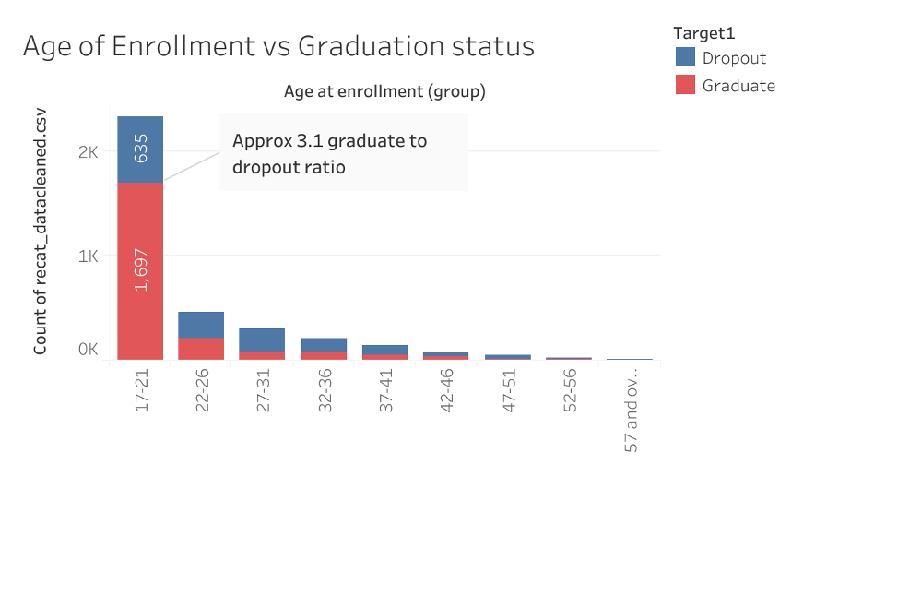
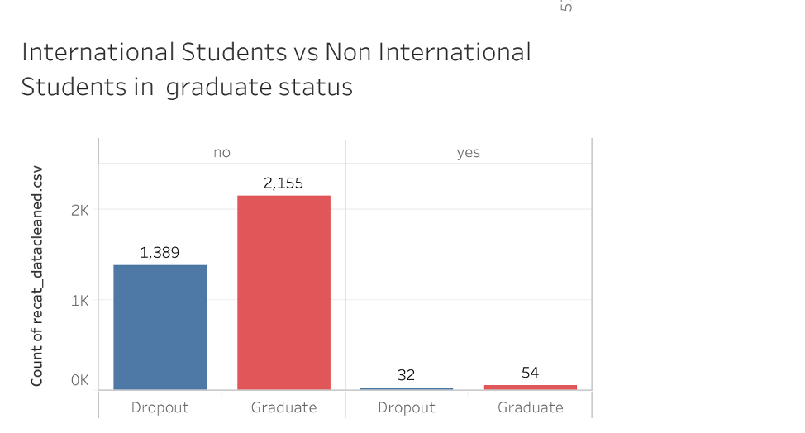
Notes:
In order to use the data in tableau visualisations the numerical data needed to be converted to the categorical data.
Comparing age of enrollment vs graduation status; In all the age groups graduate numbers are higher than the dropout numbers or at least equal.
There is a large proportion of students in the age group of 17-21 with a graduate: dropout ratio of approx 3:1.
This indicates that age group might have a significant role in academic performance and outcomes.
Comparing student national status vs graduate status: For both international and non international students, the number of graduates is significantly higher especially that for non international students.

Slide 8
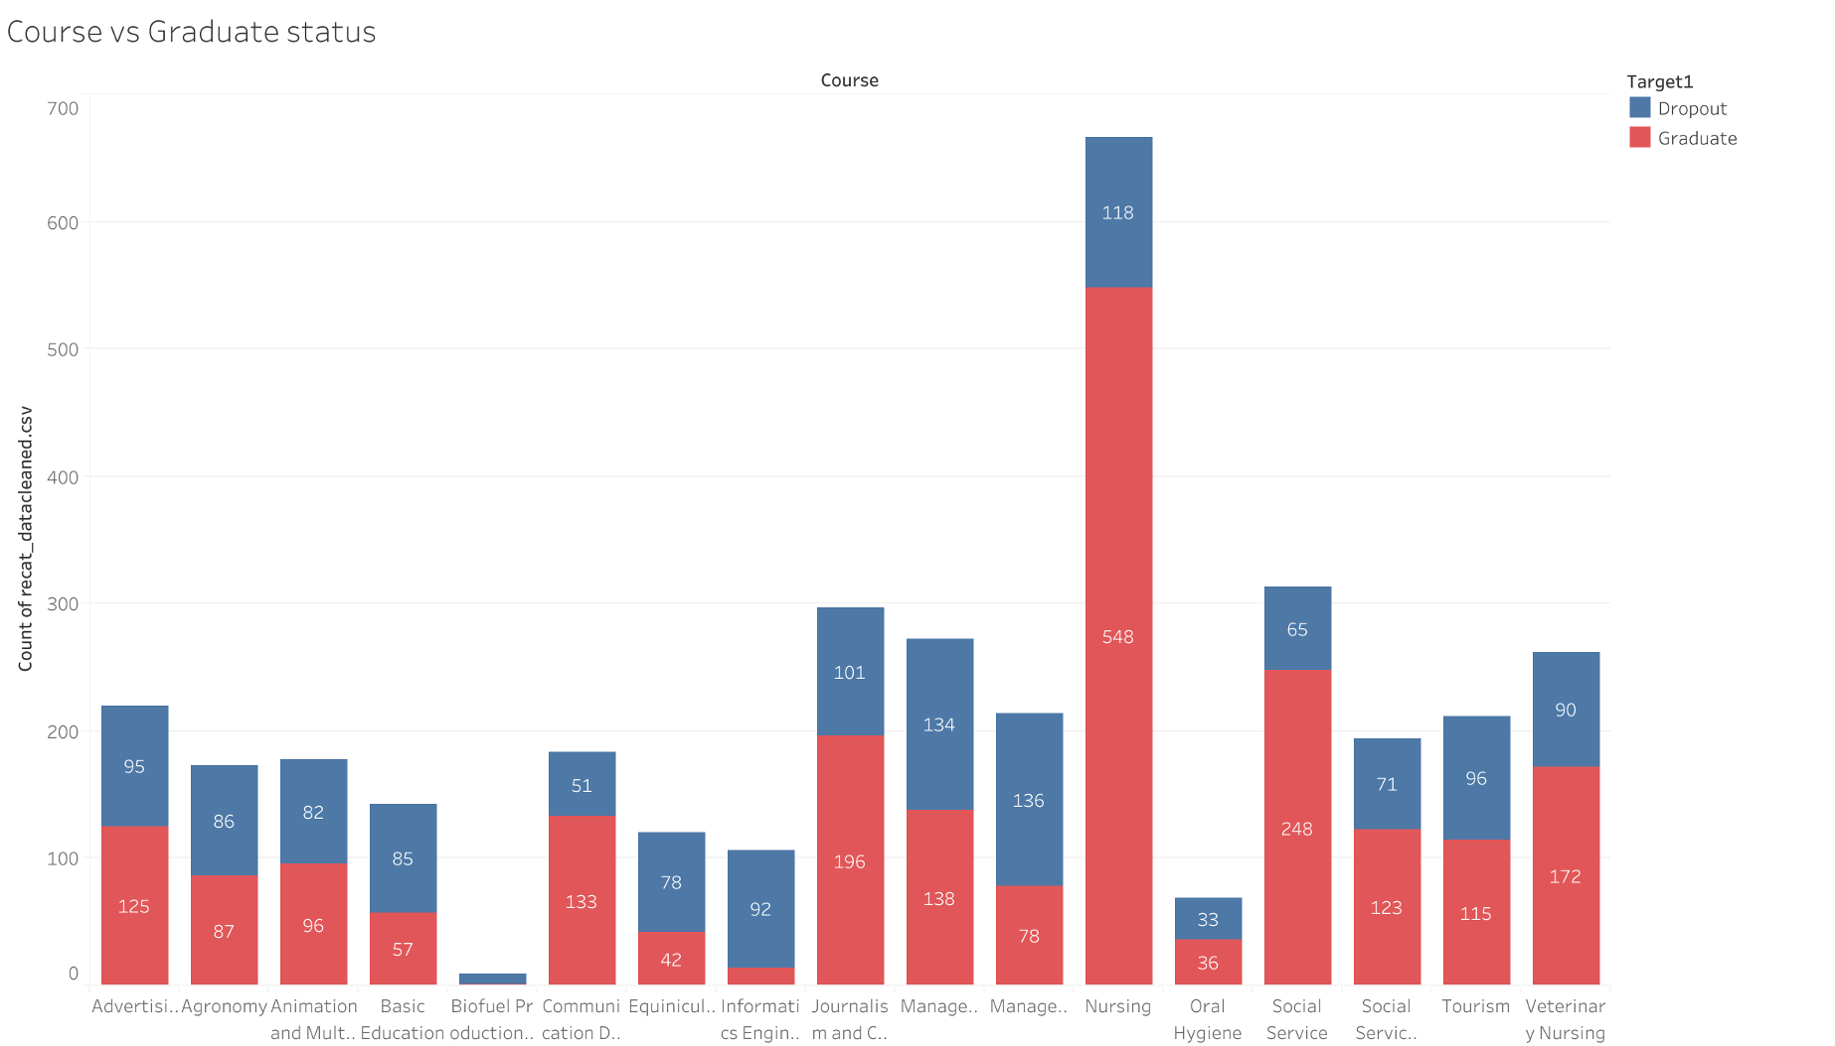
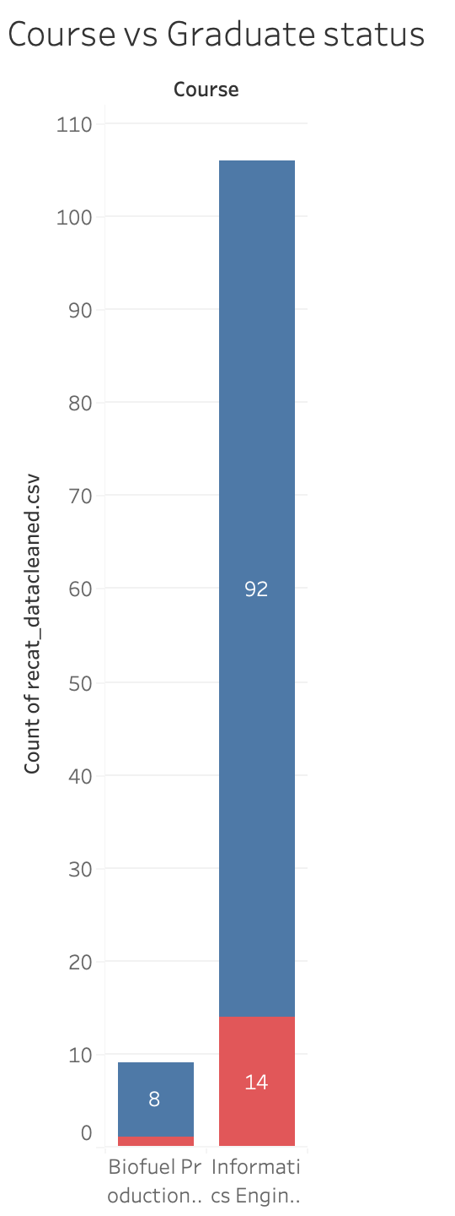
Notes:
If we break down the data by course; over all across all subjects graduate numbers are significantly higher than dropout numbers, apart from the Biofuel production and Informatics engineering courses which a significantly high number of dropouts compared to graduates.

Slide 9
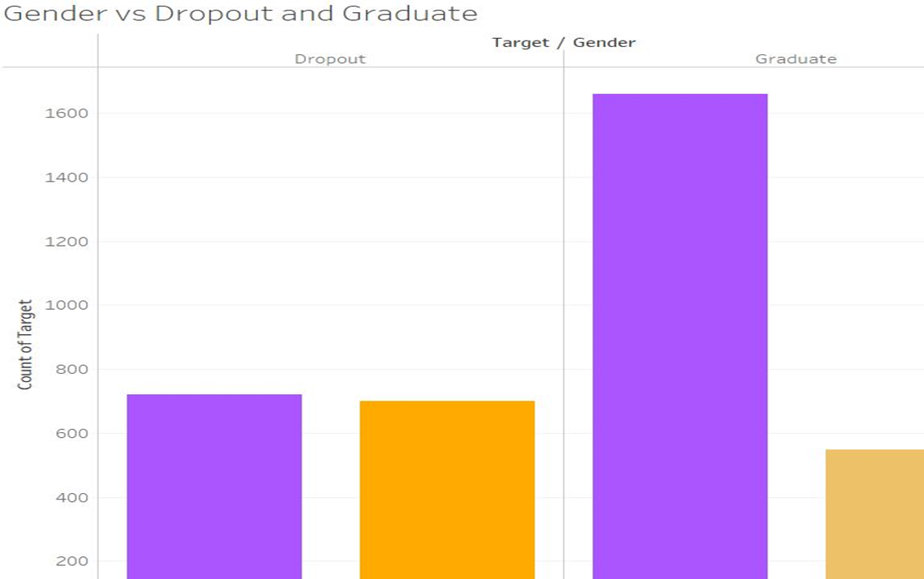
Gender VS Graduate & Dropout
•The number of dropouts for both male and female are approximately the same.
•The number of graduates is higher for females in comparison to males.

Slide 10
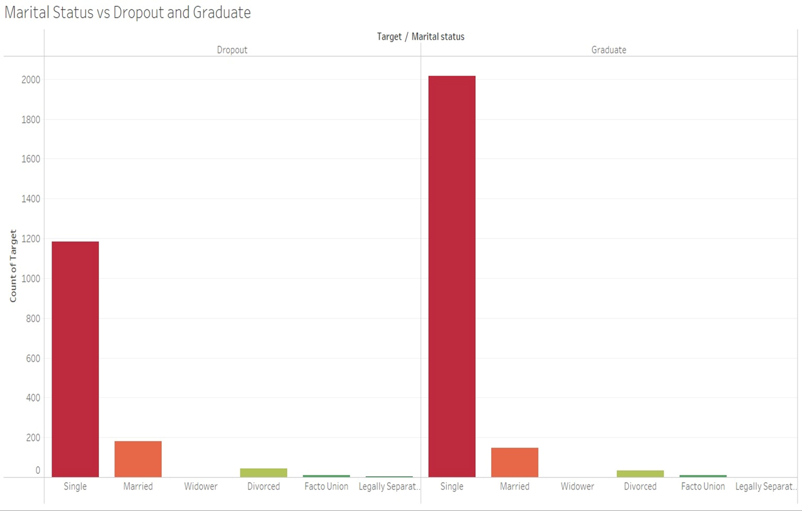
Marital Status VS Dropout & Graduate
•Single people have the most dropouts in comparison to no dropouts for widowers.
•Single people are also most likely to graduate whereas widowers are the least.

Slide 11
Machine Learning
Python 3.7.11
Pandas library version 1.4.3,
Scikit-learn library version 1.1.1,

Slide 12

Before we start we have a problem?

Slide 13
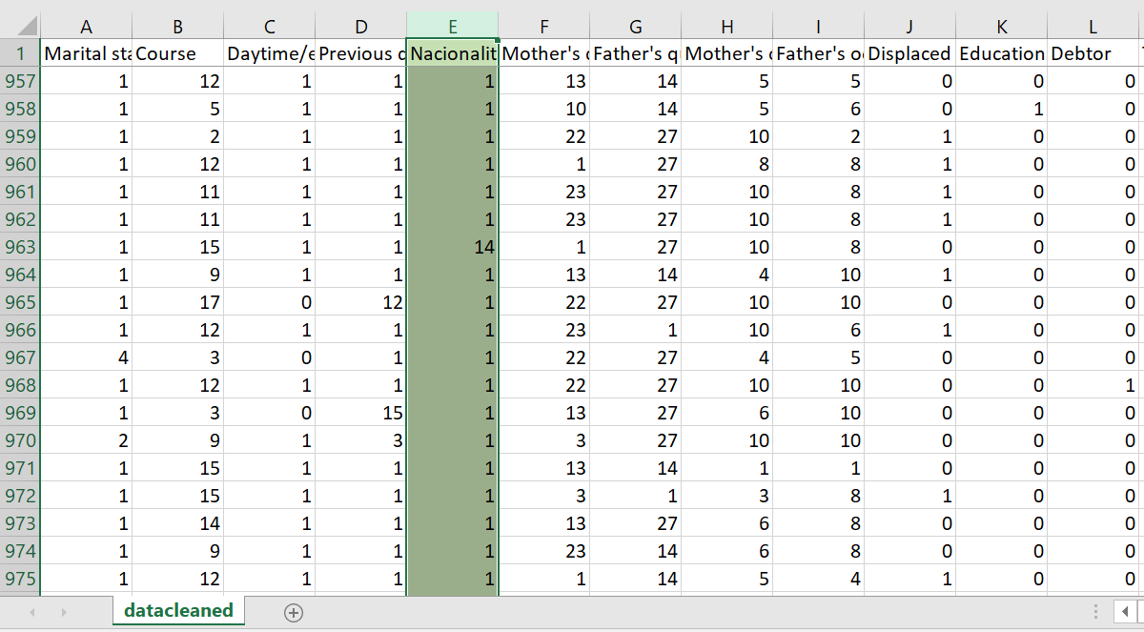

Slide 14
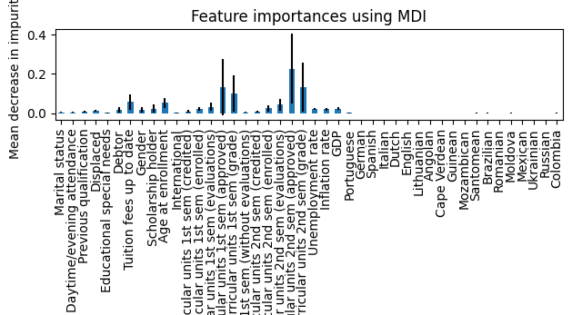
One-Hot Encoding
Notes:
we One-Hot Encoded different features. For example here we hot encoded the nationality of the students. The sample was quite small, but you can see that there is an association with the accuracy of the model if you are from poorer countries eg Santomena (Sao Tome and Principe a former Portugese colony in the Caribeean), Brazil, Moldova and Columbia .

Slide 15
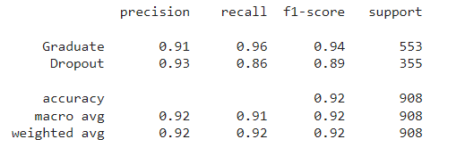
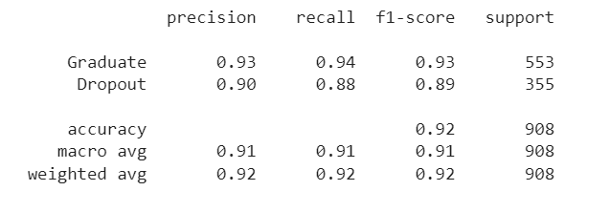
Supervised Learning Model
Classification Report
Logistic regression model.
Target variable (dependent variable): “dropout vs graduate”
32 features (independent variables)
Initial train/test split: 75%/25%
Overall accuracy 92%
Dropout Recall 86%
Notes:
A logistical regression model used to determine the target variable of “dropout vs graduate”, using the 32 attributes
We were a achieve n overall accuracy score of 92%

Slide 16
Can we improve the Dropout recall?

Slide 17
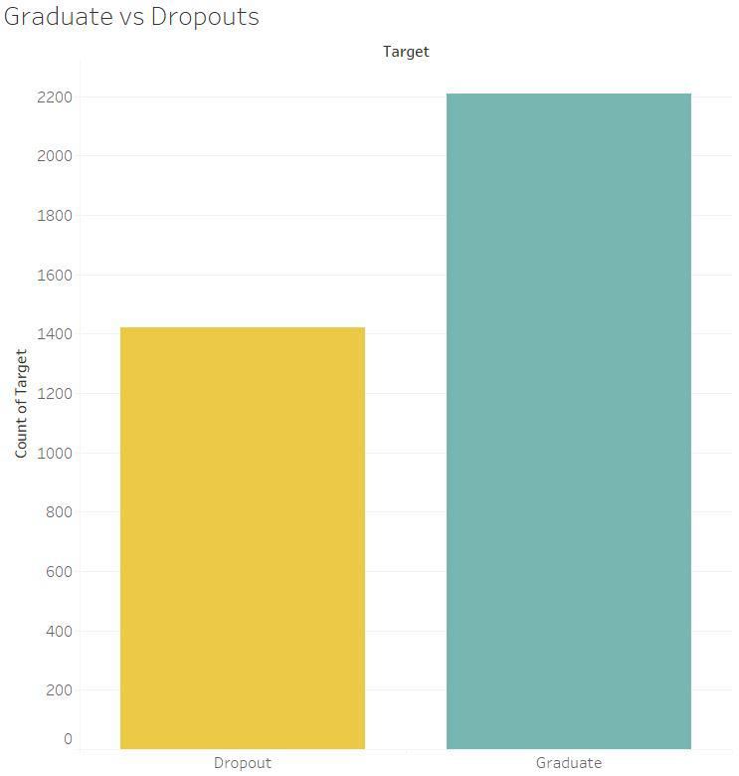
Original data was imbalanced.
Target data skewed towards graduate ( 3:2 ratio)
Notes:
Approx 2200 graduates, to 1400 dropouts

Slide 18
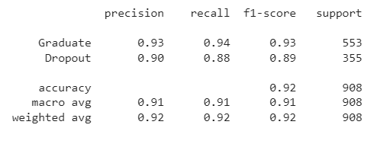



Retrain the model → RandomOverSampler Module (from Imbalanced Library)
WHEN USING THE OVERSAMPLED DATA OF THE DROPOUTS
OVERALL ACCURACY REMAINED SAME (92%)
DROPOUT RECALL INCREASED FROM 86% TO 88%
Notes:
Therefore we used the RandomOverSampler Module from the Imbalanced Library to Retrain the Model.

Slide 19
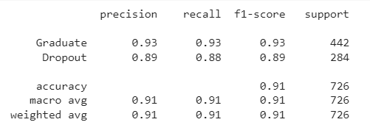
Adjust train/test split
-train/test split of 80/20
-Dropout recall & accuracy similar

Slide 20

Can we improve the model further?

Slide 21
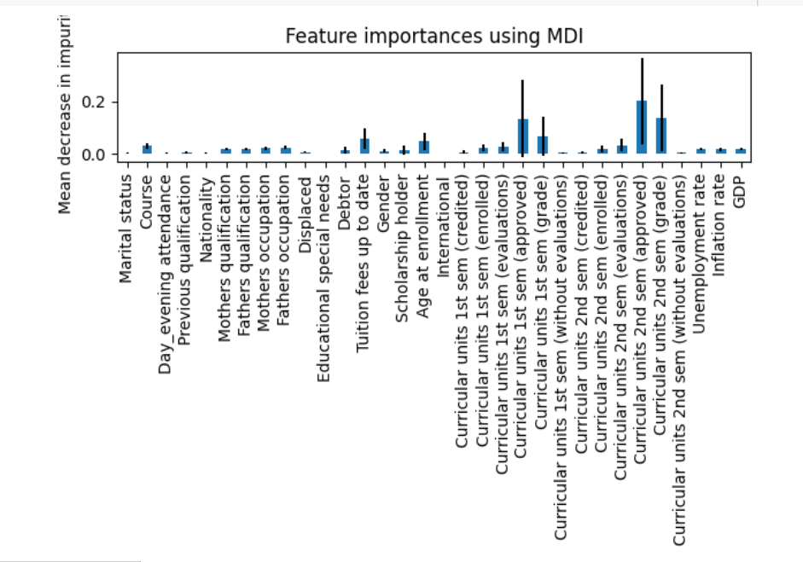
Can we identify features of importance?
-RandomForest Features of Importance capabilities
-baseline 32 features of importance
Notes:
We found fea

Slide 22
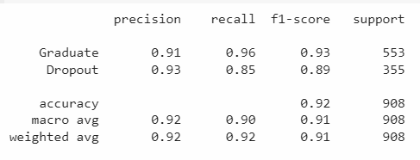
Using a Random Forest Classifier didn’t improve the model.

Slide 23
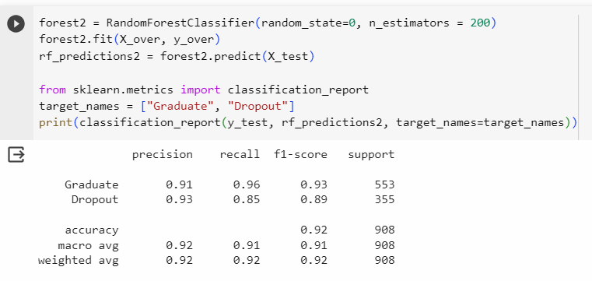
Adjusting n_estimators
Notes:
number of trees that would get used in making the decisions. By default its 100.
A decision tree is a balanced tree. A random Forest is not a balanced tree.

Slide 24
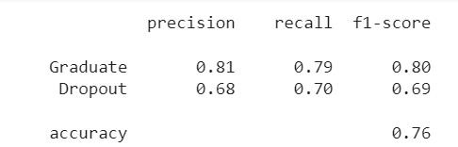
Removing curricular data features → worsened model accuracy (76% from 92%)
Notes:
So although that hasn’t worked, it has given us useful information which is quite intuitive, if you are struggling in semester 1 and 2.

Slide 25
Can we improve the model further?

Slide 26
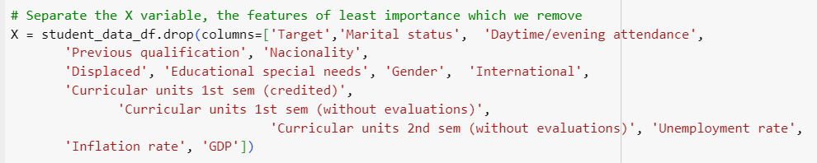
Remove all the features of least importance

Slide 27
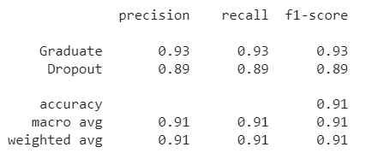
Removing Features:
Accuracy: Not improved, BUT similar to previous best
Notes:
recall -

Slide 28
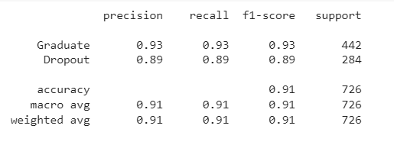
Scaling all the data
Retrain the model: Accuracy didn’t improve (91% vs previous best of 92%)
Notes:
Logistic regression doesn’t get affected by scaling

Slide 29
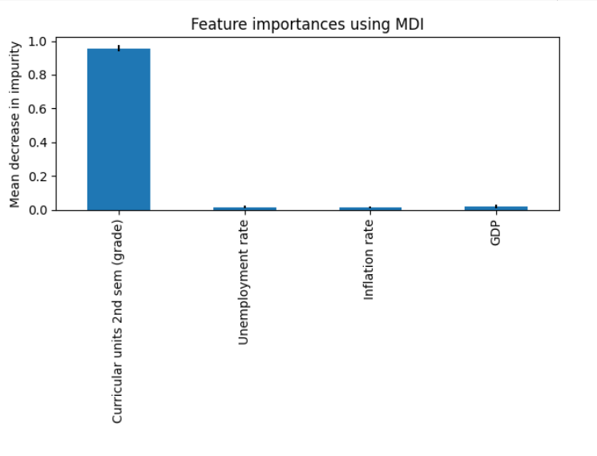
Scaling selected data

Slide 30
Conclusion
Exploratory analysis: Identified features strongly related to Dropouts:
Younger students at enrollment
Certain degrees courses (Biofuel production, Informatics Engineering)
International students status.
Accurate Supervised Learning Model created to predict Graduate/Dropout status: tried LR, tried changing split, Tried RF Classifier.
Notes:
Finally we created an accurate supervised learning model by modifying a number of status.

Slide 31
Can we improve the model further?
Using other oversampling techniques
Using other models
Notes:
Using other models eg decision tree

Slide 32
Future Steps
Would a larger dataset improve the accuracy of the model?
Do these results remain true for other universities in Portugal?
For other courses?
Other universities?

Slide 33

Questions?
Notes:
Q) what other models can you use: we stuck to sci kit learn, but we could have used neural networks.
support vector machine (called SVC in scikitlearn support vector classifier), neural networks.
CourseRA
sklearn.ensemble.RandomForestClassifier — scikit-learn 1.3.1 documentation we could have adjusted the maximum depth of the tree, the split (criterion)

